Slide 1
SYSTEMVERILOG FINAL PROJECT
TEAM 22:
Sai Teja Gali
Abhishek Musku
Sandeep Goud A.
Sujith Vallapureddy

Slide 2
Aim of The Project
Implementation of Memory and IO modules for 8088 Microprocessor
Implementation of CS for Memory & IO Modules
Implementation of Interface for 8088 processor
Perform valid Read & Write Operations for all the Memory & IO Modules

Slide 3
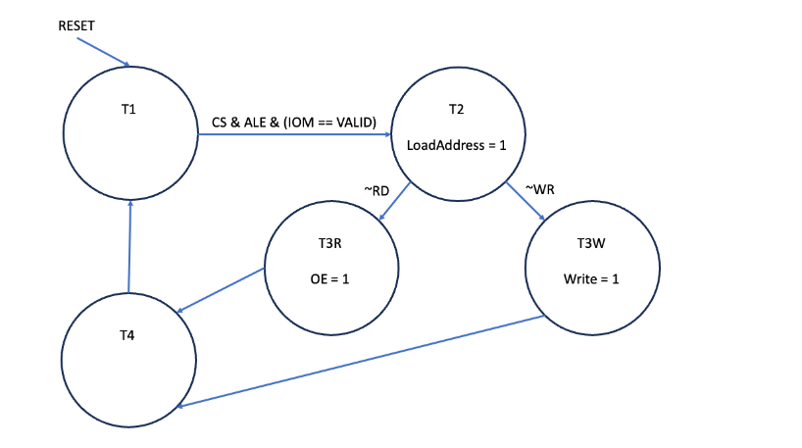
FSM

Slide 4
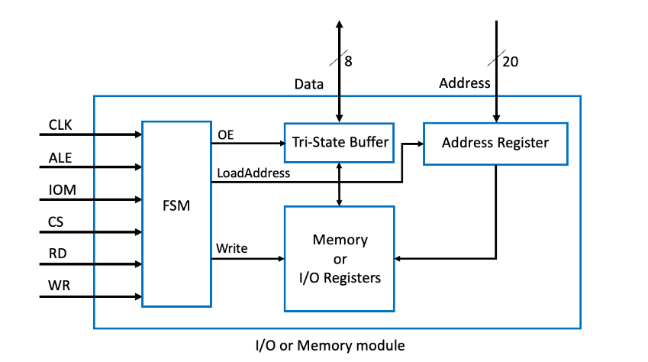
Black Box
DEN

Slide 5
Files included
8088if.svp - 8088 Microprocessor Module
IO.sv – IO module
mem.sv – Memory Module
top-3.sv – Testbench
mo.txt & m1.txt – to initialize all the memory
io.txt & i1.txt – to initialize IO modules
Busops.txt – input file read by 8088if.svp
Run.do – File to compile and run the project

Slide 6
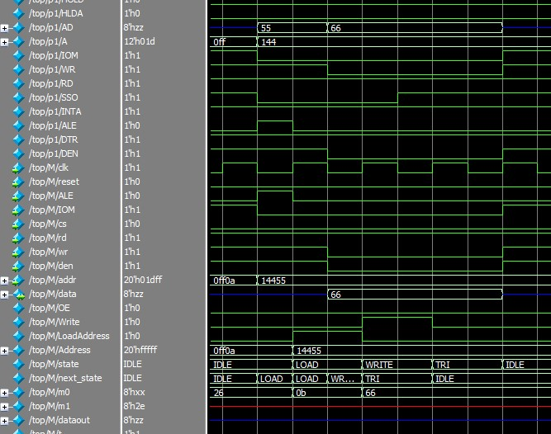
Output for Write Operation

Slide 7
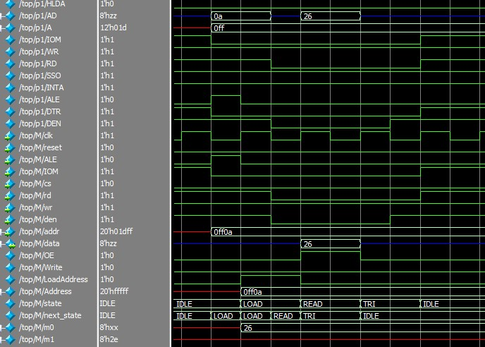
Output for Read Operation

